Slide 1
The Heartland Corridor

Slide 2
Introducing the Heartland Corridor
The Heartland Corridor is a portfolio of intermodal based products designed to significantly improve mobility and increase freight capacity between the Mid-Atlantic regions of Virginia and North Carolina, and the Midwest and West Virginia.

Slide 3
Heartland Corridor:
Key Project Components
“Central Corridor Double-Stack Project”
  Double-Stack Clearances: Between Roanoke, VA through WV, to Columbus, OH
  New Intermodal Terminals
    Prichard, WV
Expanded Intermodal Capacity
  Columbus, OH – Rickenbacker Airport
  Columbus, OH – Triple Crown
  Roanoke, VA – New Terminal
“Western Freeway Rail Corridor”
  Rail relocation project in Portsmouth, VA

Slide 4
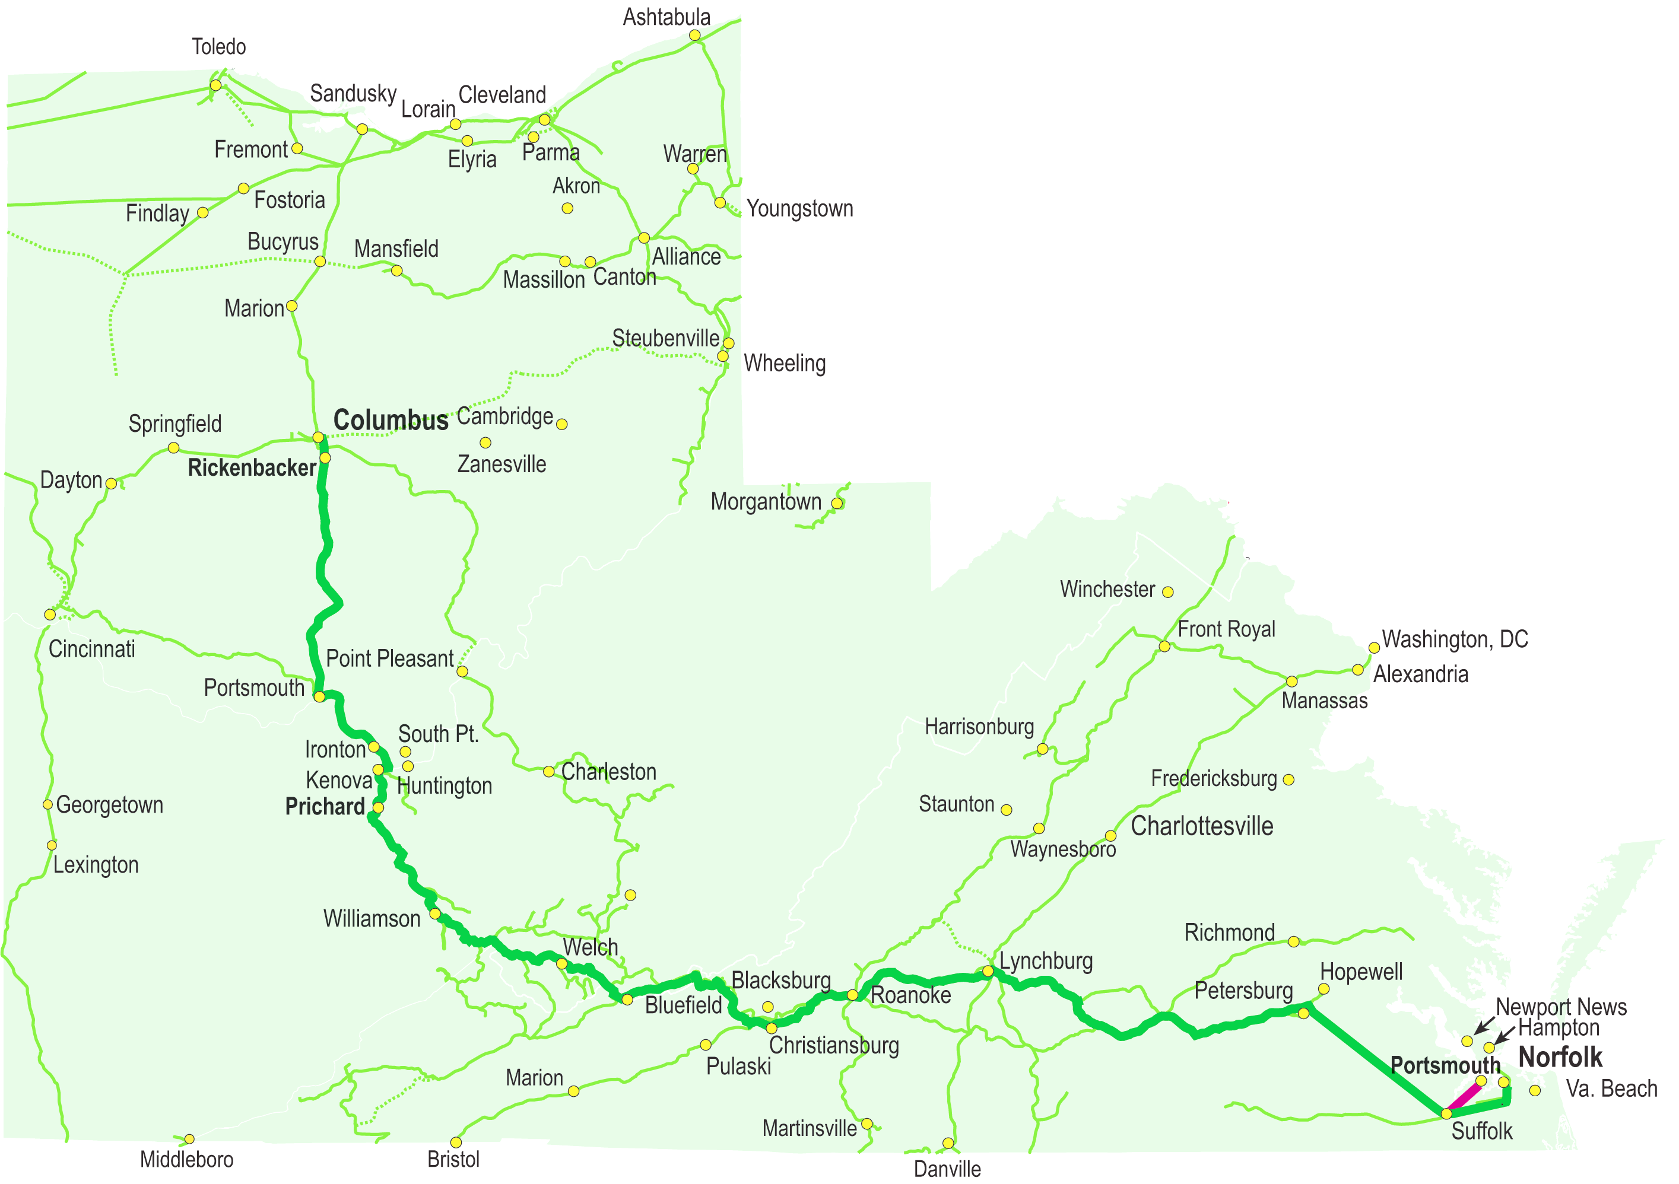
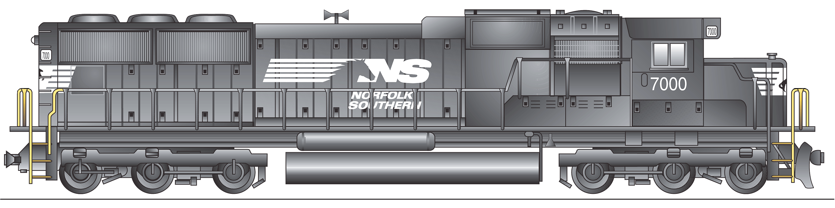
The Heartland Corridor
To Detroit, Toledo, Chicago and all points west
Heartland Corridor
Other NS rail lines
Commonwealth Railroad
New/Expanded Intermodal Terminals
To Greensboro and Charlotte

Slide 5
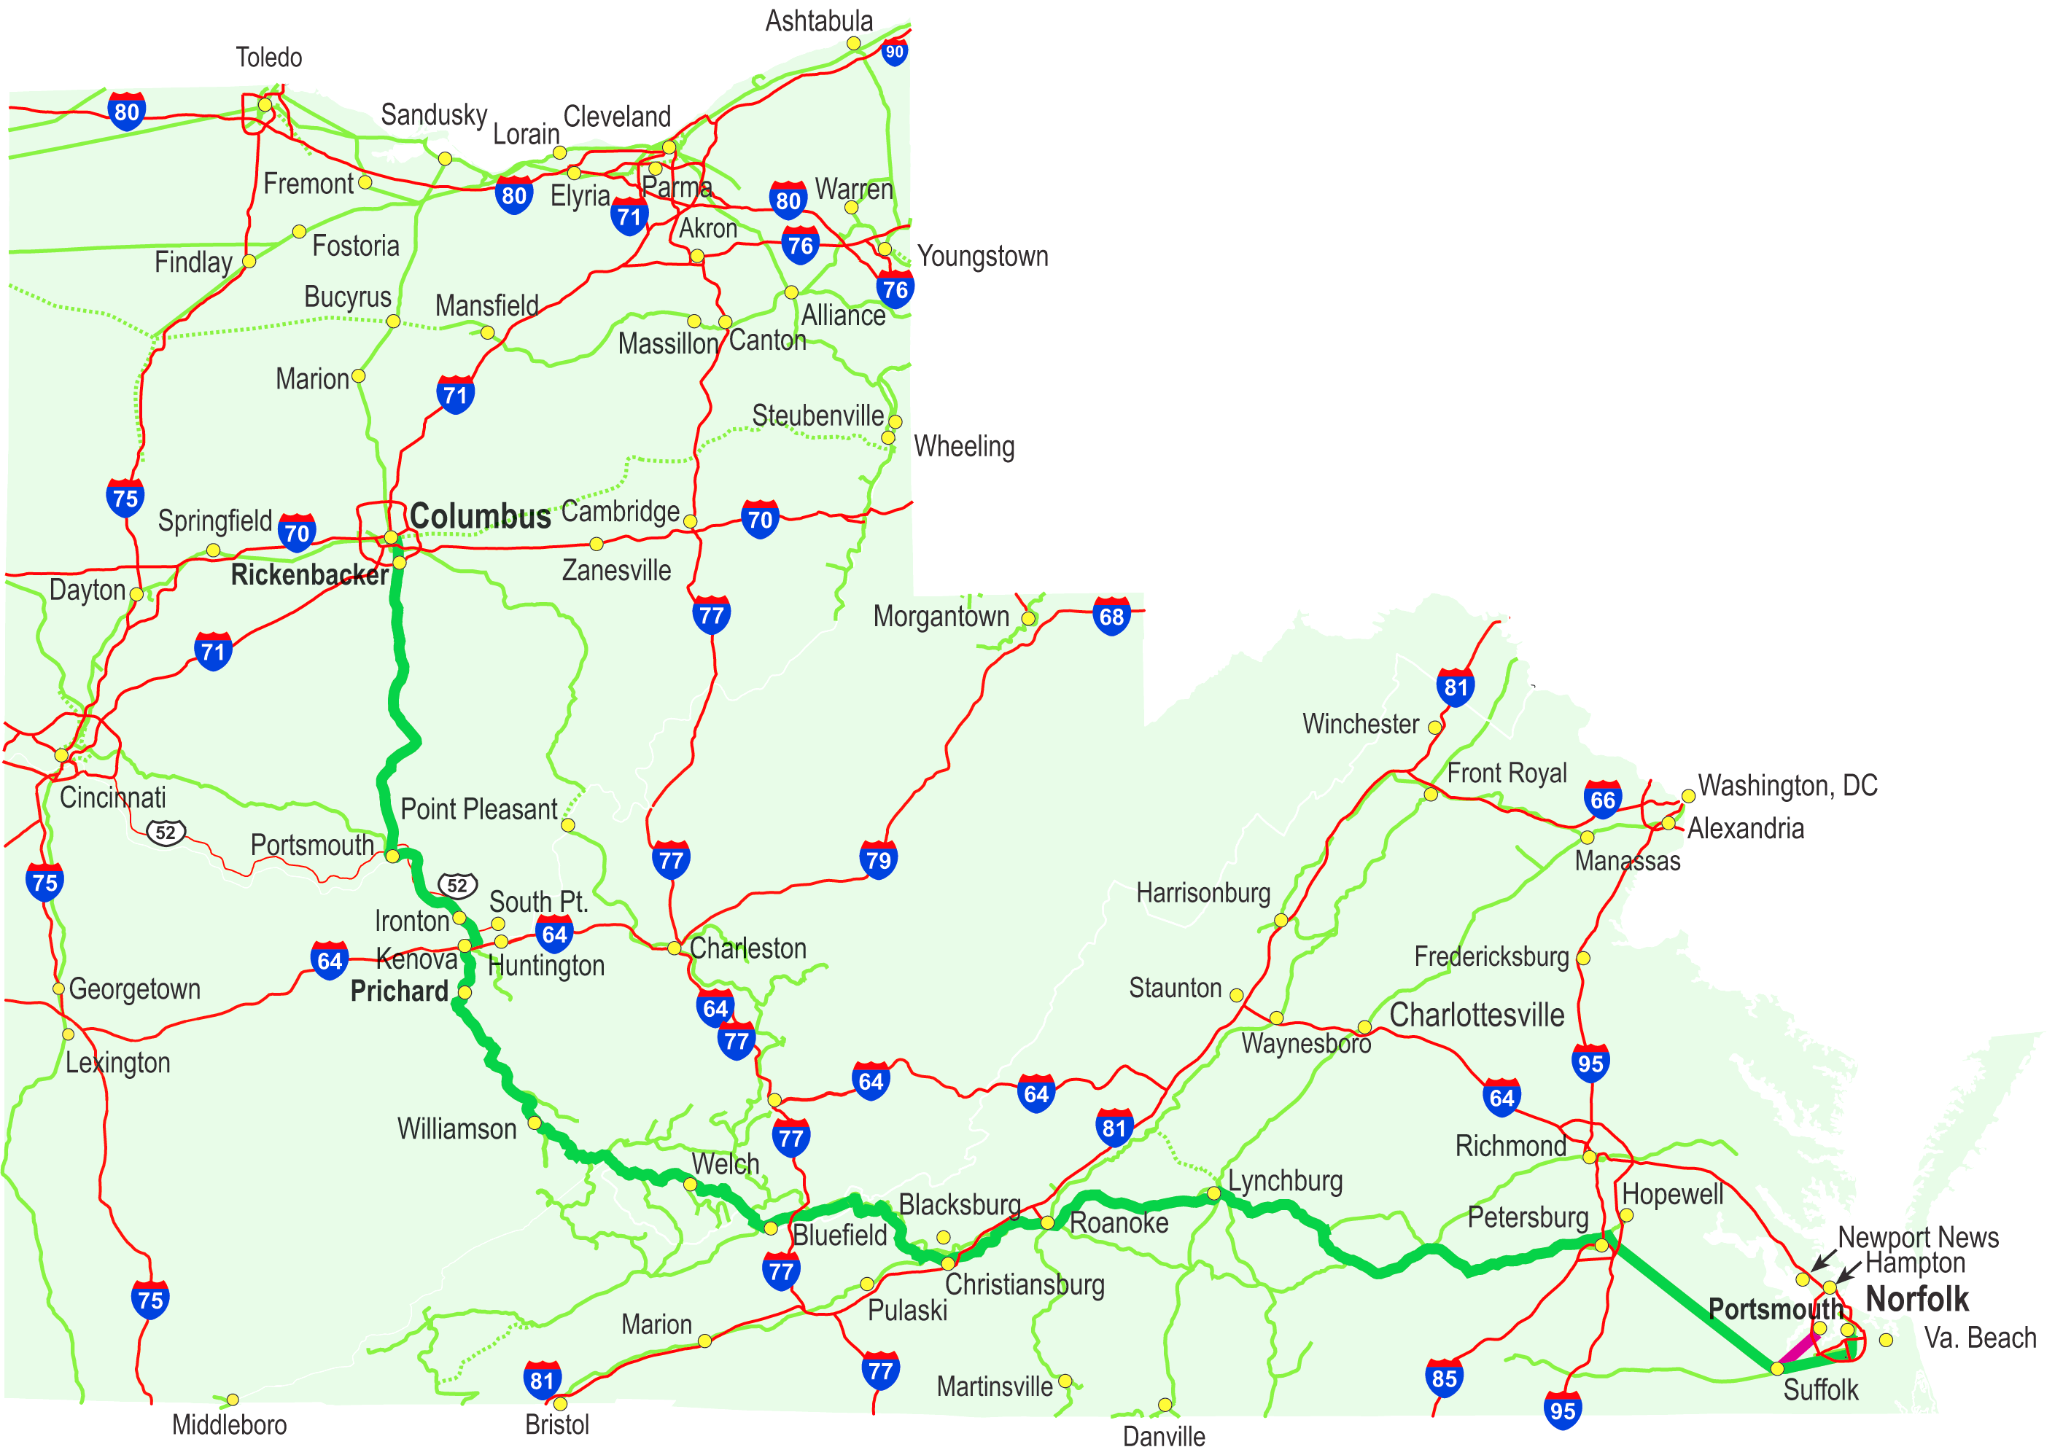
The Heartland Corridor
Heartland Corridor
Other NS rail lines
Commonwealth Railroad
US Interstate System
New Intermodal Terminal

Slide 6
Supporting Projects Outside of Scope
Terminal Expansion – Front Royal, VA
New Terminal – Petersburg, VA
New Classification Facility – Between Suffolk and Petersburg, VA

Slide 7
Central Corridor Double-Stack Project: Clearances
Description: This project will increase the vertical clearances above the high-speed, high capacity NS main line between Columbus , OH and Roanoke, VA. Upon completion, the rail network will have a fully cleared direct route between Chicago, IL and Norfolk, VA, and all markets in between. This cleared network will provide for the intermodal movement of goods between Virginia, North Carolina and West Virginia, Ohio and the rest of the Midwest in a highly efficient double-stack configuration.
Cost: $112 Million

Slide 8
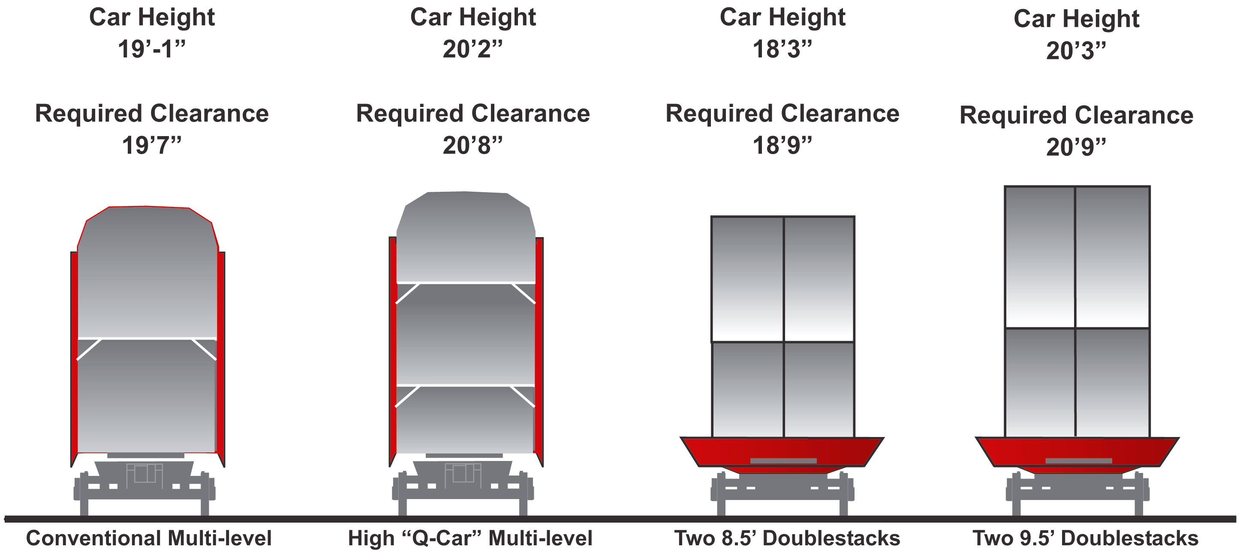
Central Corridor Double-Stack Project: Clearance Requirements

Slide 9
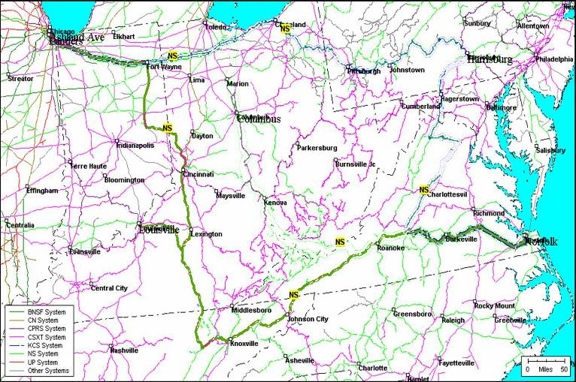
Chicago
Cleveland
Harrisburg
Columbus
Prichard
Kenova
Roanoke
The Port
of Virginia
Heartland Corridor

Slide 10
Heartland Corridor: Central Corridor Double-Stack Project Scope
28 Tunnels
  30,000+ feet to be Cleared
  Virginia, West Virginia, and Kentucky
  $109 Million
24 Overhead Obstructions
  Bracing Modifications, Fencing Modifications, Overhead Wire Removal, Miscellaneous Signal Work
  West Virginia, and Ohio
  $3 Million

Slide 11
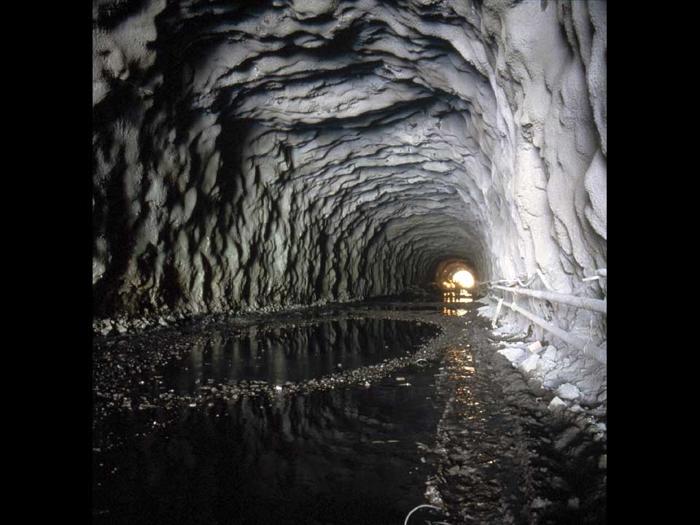
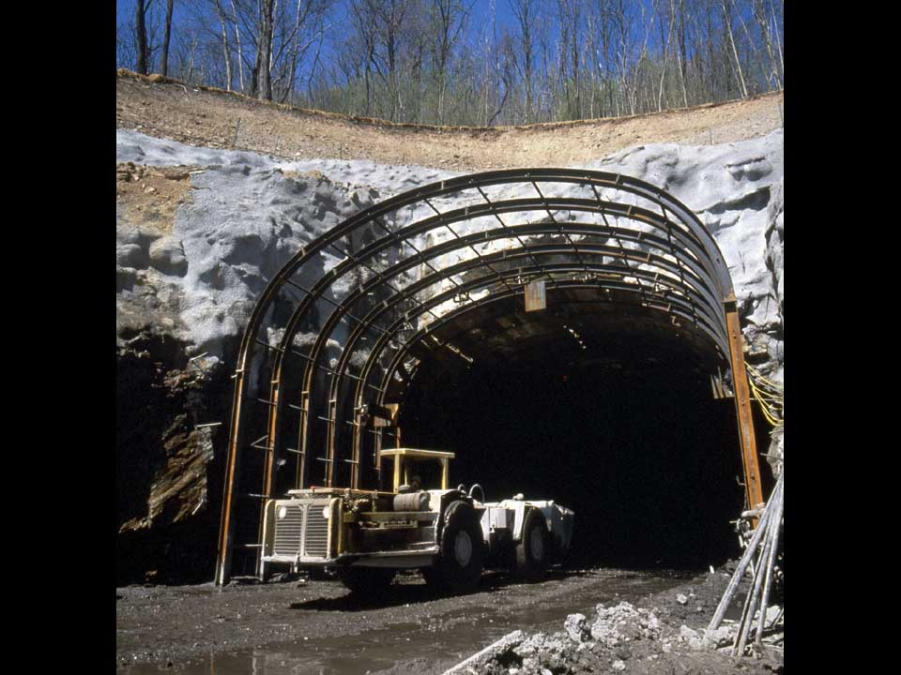
The Project Is Similar To the Clearance Improvements in Pennsylvania in 1993-1995

Slide 12
Central Corridor Double-Stack Project: Prichard West Virginia Intermodal Terminal
Description: This project involves construction of a new intermodal terminal facility in Prichard, WV. This terminal will provide Prichard and the surrounding markets with direct intermodal access to global markets. Intermodal service will be provided between Prichard and Chicago and all points west, as well as the ports in Hampton Roads
Phase 1 Capacity: 30,000 units
Cost: $18 Million

Slide 13
The Heartland Corridor
Prichard Intermodal Terminal
Heartland Corridor
Other NS rail lines
Commonwealth Railroad
US Interstate System
New Intermodal Terminal

Slide 14
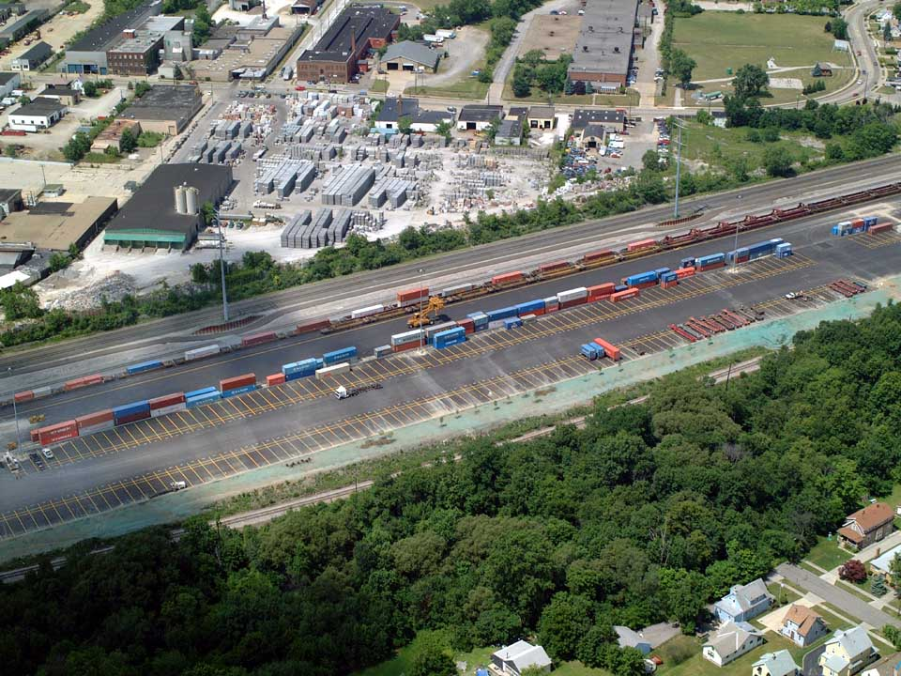
The Facility in Prichard Will Be Similar in Scope and Design to Norfolk Southern’s New Facility in Cleveland, OH

Slide 15
Qualified Benefits of the Central Corridor Double-Stack Project
Provides a new intermodal facility in West Virginia, a region that currently has no intermodal connections to the domestic and global intermodal network.
Provides new, lower cost intermodal freight transportation options to shippers in the Appalachian regions of West Virginia, eastern Kentucky, and southeastern Ohio. This infrastructure improvement will provide a base for attracting new business to the region.
Facilitates conversion of freight from highway to rail
  Reduces traffic congestion on key highways along the Heartland Corridor
  Reduces emissions by up to 75% on freight converted to rail

Slide 16
Quantified Benefits of the Central Corridor Double-Stack Project
According to a study performed by the Nick J. Rahall Appalachian Transportation Institute at Marshall University, the Central Corridor Double-Stack Project provides the following financial benefits
  Over 20 years, provides $201 to $368 million in economic benefits to shippers moving freight in the Heartland Corridor
  Increases economic activity in West Virginia by $50 million per year with associated increases in employment and tax revenue, as well as providing $4.4 million to $11.3 million in direct benefits annually to existing shippers in West Virginia, eastern Kentucky and southeastern Ohio.

Slide 17
Heartland Corridor:
Expanded Terminal Capacity
Description: The Heartland Corridor project will create significant new Intermodal capacity in Columbus, OH and Roanoke, VA
  This project provides for a major new state of the art intermodal facility adjacent to the Columbus Regional Airport Authority’s Rickenbacker Airport, south of Columbus.
  This project also converts the existing Discovery Park Intermodal terminal in Columbus, OH in to a roadrailer terminal. The roadrailer network would connect Columbus to markets throughout the Midwest, South, and Northeast, and the Mexican gateway. The roadrailer services serve a variety of industries, with a focus on the auto parts business.
  This project provides for a new Intermodal facility in the Roanoke Valley region of western Virginia.

Slide 18
Heartland Corridor:
Expanded Terminal Capacity (Cont’d)
Phase I Capacity, Rickenbacker: 250,000
Phase I Capacity, Discovery Park: 100,000
Phase I Capacity, Roanoke: 17,000
Cost: $76 Million

Slide 19
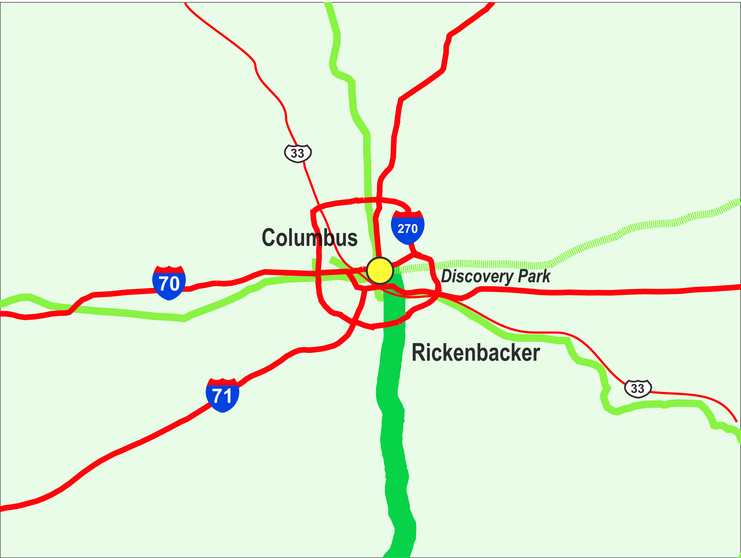
Heartland Corridor
Other NS rail lines
US Interstate System

Slide 20
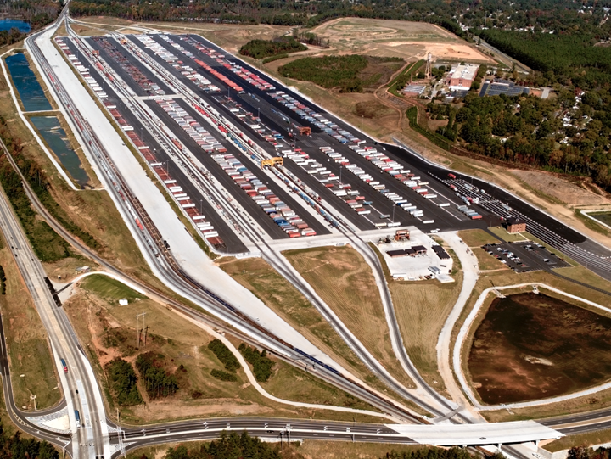
The New Columbus Facility Will Be Similar in Scope and Design to NS’ New Austell Facility in Atlanta, GA

Slide 21
The New Facility in the Roanoke Valley Will Be Similar in Scope and Design to Norfolk Southern’s New Facility in Cleveland, OH

Slide 22
Heartland Corridor
Qualified New Terminal Benefits
Provides expanded capacity for highly efficient, low cost intermodal transportation in central Ohio.
Introduces intermodal shipping options to western Virginia and WV for the first time.
Preserves central Ohio’s status as the distribution hub of the Midwest
Contributes to lower truck mileage and emissions on Ohio Interstates
Provides significant employment, tax and other economic benefits

Slide 23
Heartland Corridor
Quantified Columbus Terminal Benefits
According to a study performed by Insight Research for the Columbus Regional Airport Authority and Norfolk Southern, these terminal projects in Columbus will provide the following benefits:
Annual direct and indirect taxes by 2028
Annual direct jobs by 2028
Annual indirect jobs by 2028
Other Economic impact by 2028
$100.9 million
9,473
10,860
$1.044 billion

Slide 24
Heartland Corridor:
Western Freeway Rail Corridor
Description: In Portsmouth, VA, the Heartland Corridor Project will relocate an existing Commonwealth Railroad rail line in Portsmouth, VA. The line will be moved from its current route through densely populated areas of Portsmouth, VA to a new route contained in the median of the Western Freeway and I-664.
Cost: $60 million

Slide 25
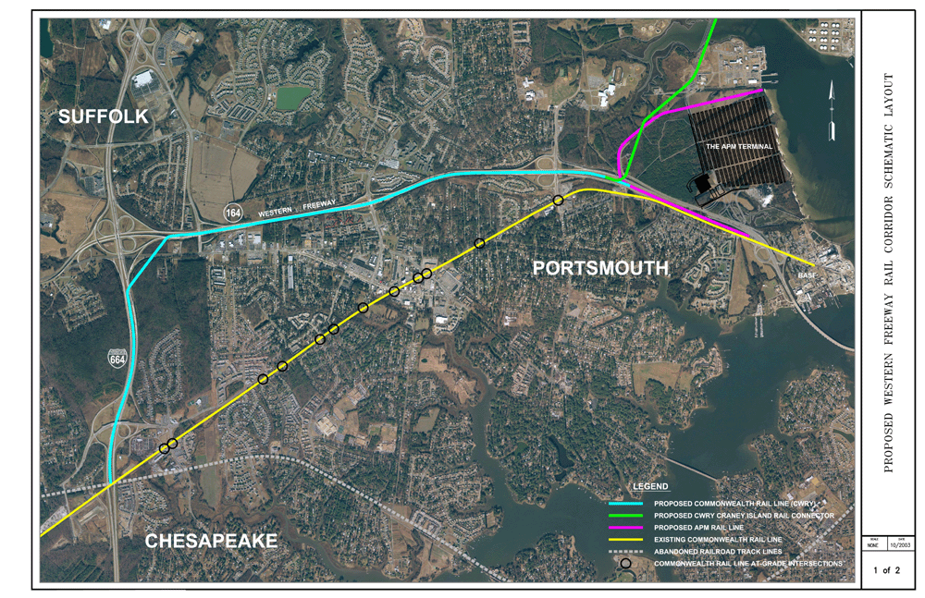
The New Route Is North of the Existing Commonwealth Railway Line
To Craney Island

Slide 26
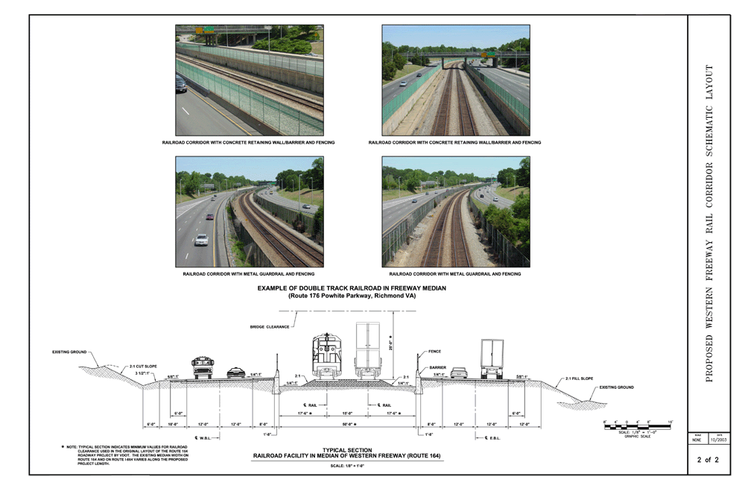
The New Route Will Look Similar to Other Highway Median Rail Corridors

Slide 27
Western Freeway Rail Corridor Benefits
Fully grade separates route of the Commonwealth Railway between the proposed ports of Craney Island and Maersk’s Cox property and the national intermodal network
Eliminates of 12 grade crossings in largely urban areas of Portsmouth, VA that are likely to see large increases in rail activity (12 trains per week currently to over 36 trains per week by 2016).
Reduces truck traffic, particularly on eastern portion of I-64 and US 460
Further enhances Hampton Roads’ position as a major player in expanding global trade

Slide 28
Heartland Corridor:
Project Summary
Central Corridor Double-Stack Initiative and Prichard Intermodal Terminal
New terminal capacity in Columbus, OH and Roanoke Valley, VA
Western Freeway Rail Relocation Project
$130 million
$76 million
$60 million

Slide 29
Overall Benefits of Heartland Corridor Project
Improved mobility for motorists and truck freight along the Heartland Corridor, including some mobility benefits on the I-81 segment between Staunton and Lexington, VA
Environmental benefits from reduced emissions through use of more efficient rail transportation
Economic, tax and employment benefits from the introduction of new or expanded Intermodal capacity along the Heartland Corridor
Preservation of rail infrastructure and employment on a rail corridor facing declines in coal traffic
Reduced shipping costs for shippers along or shipping via the Heartland Corridor
Improved access to the global trade network through the Ports of Hampton Roads for shipper and manufacturers in Virginia, West Virginia, eastern Kentucky and Ohio

Slide 30
The Heartland Corridor
Federal Highway Administration’s Involvement

Slide 31
Heartland Corridor:
How did Eastern Federal Lands Highway Division get involved?
Associate Administer for Federal Lands Highway, Mr. Arthur Hamilton, and his staff met with State transportation officials, local officials, and representatives of the Norfolk and Southern Railroad regarding the Heartland Corridor Clearance Project.
Officials from the States of Ohio, Virginia, and West Virginia requested that FHWA take the lead in moving the project forward.
Based on those discussions, the FHWA would take the lead, with consent of the three States, in administering the funds authorized for the project by SAFETEA-LU.

Slide 32
Heartland Corridor:
Why Eastern Federal Lands Highway Division?
Ability to:
Implement project agreements
Complete NEPA compliance for federally funded work
Administer earmarked funds disbursed over multiple states

Slide 33
Heartland Corridor:
Project Agreements
Memorandum of Agreement with States of Ohio, West Virginia, and Virginia
Memorandum of Agreement with Norfolk Southern Railway Company

Slide 34
Heartland Corridor:
MOA with States
Purpose of the MOA was to establish roles and responsibilities of ODOT, WVDOT, VDOT, and EFLHD
State DOTs agreed to:
  Request federal funding for the project
  Authorize that the funding be transferred directly to EFLHD
  Cooperate with the EFLHD and the Railroad when State involvement is required to advance the project
EFLHD agreed to:
  Coordinate overall schedule and facilitate cooperation
  Accept and manage Federal funding for the project
  Act as lead agency for NEPA compliance
  Provide quarterly status reports to State DOTs
  Provide to the State DOTs as appropriate plans and other design documents for review

Slide 35
Heartland Corridor:
MOA with Railroad
Purpose of the MOA was to establish roles and responsibilities of the Railroad and EFLHD
Railroad agreed to:
  Participate in the environmental review
  Prepare monthly written reports
  Submit plans to EFLHD for review and approval
  Award and administer design and construction contracts
  Obtain all necessary clearances, permits, licenses, and other approvals prior to construction
  Ensure that construction contacting is done competitively in accordance with the Federal Acquisitions Regulations
  Send EFLHD bid packages so that solicitations can be posted on State DOT websites
  Provide staff to inspect and supervise construction work
  Maintain all project records and make available for inspection

Slide 36
Heartland Corridor:
MOA with Railroad
Purpose of the MOA was to establish roles and responsibilities of the Railroad and EFLHD
EFLHD agreed to:
  Coordinate overall schedule and facilitate cooperation
  Accept and manage Federal funding for the project
  Act as lead agency for NEPA compliance
  Provide quarterly status reports to the State DOTs and Railroad
  Serve on any selection panel convened by the Railroad

Slide 37
Heartland Corridor:
MOA with Railroad
Funding and Reimbursement
Federal funding available for the project requires a “State Match” of 20%, which for Section 1301 funds will be provided by the Railroad and for Section 1702 by the State or the Railroad.
EFLHD will provide Federal funding up to 80% of the total project costs, up to the amount available under the law.
EFLHD’s costs for the environmental review and general project oversight will be reimbursed out of this 80%.
The Railroad is responsible for the remaining total cost of the project.
The Railroad may bill the EFLHD for any and all actual and approved costs within the scope of the project.
Upon receipt of invoices, the EFLHD will promptly make payment to the Railroad after review and approval of the invoice.
The Railroad certifies that it has on hand sufficient funds to meet all of its obligations.
The Railroad will own all of the improvements constructed or completed under this agreement.

Slide 38
Thank you!
Questions??

